Slide 1
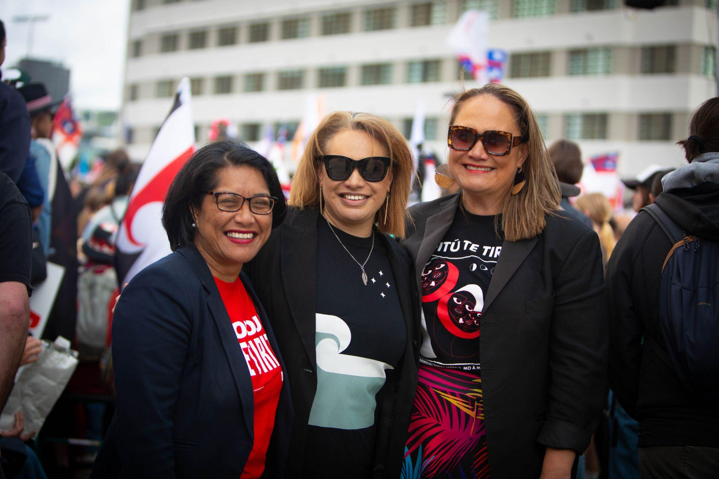
Privacy, Disinformation and the Safety of Women in Public Leadership
Tory Whanau
Former Mayor/Consultant
May 2026

Slide 2
Thanks
Dr Sanjana Hattotuwa is an internationally recognised researcher specialising in disinformation, online harms, violent extremism, and information integrity. Formerly Research Director at The Disinformation Project in Aotearoa New Zealand, his work examines how digital ecosystems, hate speech, and misinformation impact democracy, social cohesion, and vulnerable communities, including wāhine Māori and women in public leadership.
Dr Cassandra Mudgway is a New Zealand academic and researcher whose work focuses on gender, media representation, online abuse, and the treatment of women in public life. Her research explores how misogyny, racism, and disinformation intersect within digital and political environments, particularly for wāhine Māori and women leaders.
Jacqueline Comer is the co-founder of Areto, an Aotearoa-based technology and advocacy organisation focused on addressing online harm, harassment, and digital safety. Her work centres on protecting women, gender-diverse people, and public figures from coordinated online abuse through technology, education, and systems-level advocacy.
Tina Ngata is a Māori writer, researcher, and activist known for her work on Indigenous rights, Te Tiriti o Waitangi, media narratives, environmental justice, and decolonisation. She is a prominent public commentator on racism, misinformation, and the impacts of online and political hostility toward Māori communities and leadership.

Slide 3
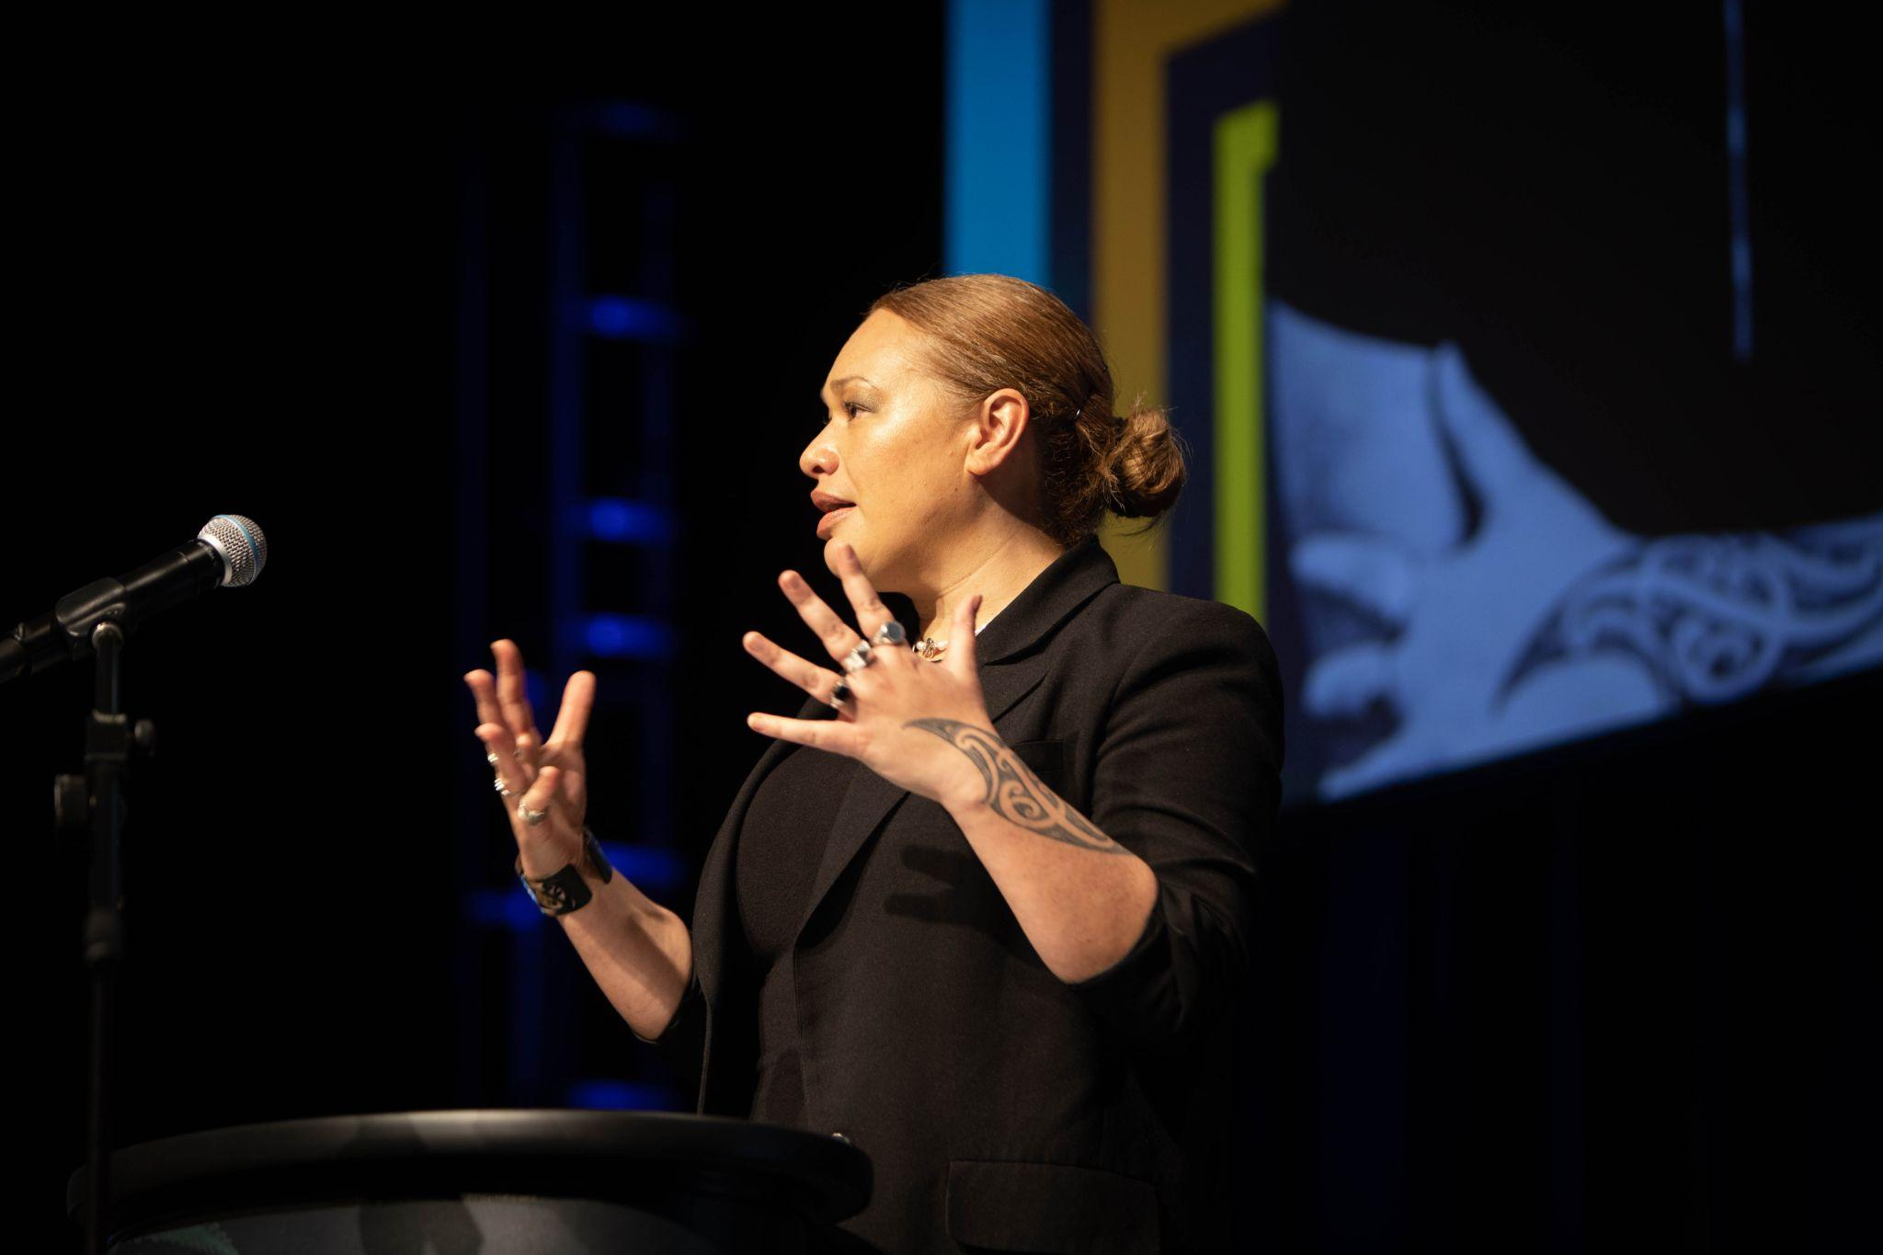
About me
A Māori political leader, strategic advisor, and former Mayor of Wellington City, where I became the first Indigenous person to hold the role. My background spans executive political leadership, governance, strategic communications, and public advocacy, including serving as Chief of Staff to the Green Party of Aotearoa.
My work increasingly focuses on the intersection of disinformation, online harm, democracy, and the safety of wāhine Māori in public leadership, drawing on both lived experience and systems-level leadership expertise.

Slide 4
Mana Wahine Inquiry
Reflections

Slide 5
Coordinated Digital Harm
Technology-facilitated abuse exists on a spectrum ranging from misinformation and defamation through to coordinated harassment, reputational violence, and real-world safety threats. AI, Search and Recommendations also form a crucial part of this eco-system but this presentation focuses on the former.
1
Social media platforms
2
Closed network and messaging
3
Forums and networks

Slide 6
Why this korero is important
DEMOCRACY
DIGITAL ENVIRONMENT
With fewer wahine Maori participating or being pushed out leads to diminished representation.
Hostile online environments are increasingly becoming part of the role.
GENDER EQUITY
SAFETY
The cost is higher for women and gender diverse people.
Leadership should not require enduring harm

Slide 7
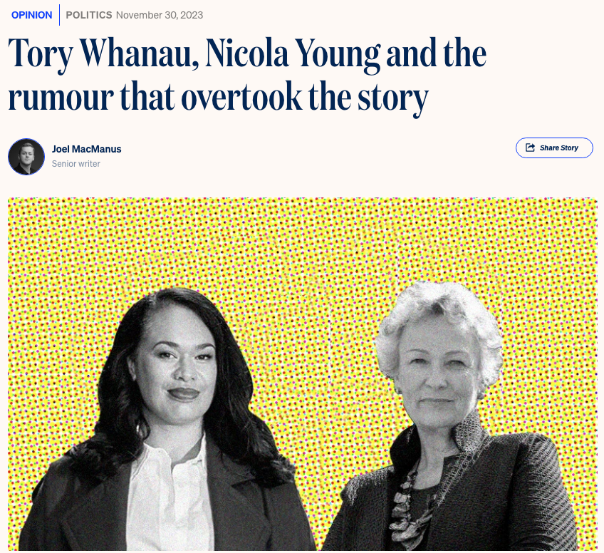
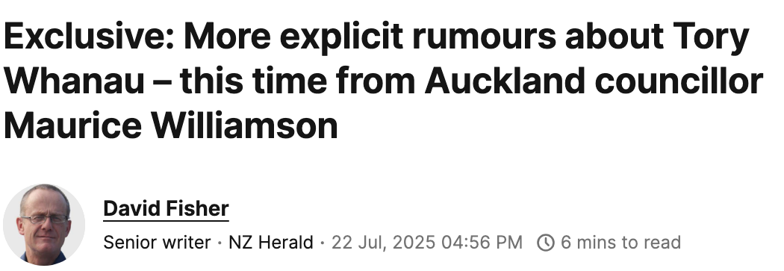
What does it look like?
False narratives spread faster than corrections
Personal information used as a weapon
Abuse escalates when amplified
Staff and family also targeted
Becomes core media narrative
It’s not one incident. It’s cumulative.

Slide 8
The Pattern
party girl, throws sex parties most weekends, easy, Vaseline freak show on legs, revolting narcissistic creature, any bodies after one drink, nobodys after two drinks, she's fucking the entire city, bonking anything, always lands on her knees, drug taking cougar, night out on the gear with these two young guys, she's a hoe, once a hoe always a hoe, well known lady of Wellington night life, debaucherous, nymphomaniac, rootin' tootin' Wellington Mayor druggie, offering drugs to cum home, drug abusing mayor, drug taking, on the gear, electric puha smoking, lush, drunk, big drunk nights out, crazy drunk, sounds like she's on the wine again, so many drunk stories about her, pissed stoned greenie, alcoholic hori, hori speaks with a fork tongue, Tory the hori incompetent, atrocious mayor, worst ever, disaster, total incompetence, destroyed Wellington, hopelessly incompetent and a moron, very poor role model pendulous breasts, puffy stingray flaps, poor tits, p..... tits, revolting, vomit bowl please fake name, woman with a fake name, narcissistic, elite disconnection slapper, bitch, whory, creature, freak show, cesspool, shithouse references hit job, dirty politics, set up, coordinated attack, false narrative, victim blaming
Disinformation follows predictable cycles:
Trigger event
Narrative distortion
Amplification
Pile-on
Real-world impact
If you can see the pattern early, you can intervene early.

Slide 9
Areto Report
Online Abuse in Politics documents the online abuse experienced by two women mayors during their 2025 campaigns and measures what happened when Areto’s real-time AI moderation was activated. Former Wellington Mayor Tory Whanau and former Calgary Mayor Jyoti Gondek.
The report draws on one month of comment data across Facebook, Instagram, and TikTok.It was released at Women Deliver in Melbourne in late April 2026.
This is the first clear pattern in the data: the Identity Penalty. The abuse directed at them was not a response to anything they said or did. It was a response to who they are.
Both campaigning mayors received relentless amounts of online abuse, largely based around their individual identity: not disagreement on policy, but around race, gender, and ethnicity.

Slide 10
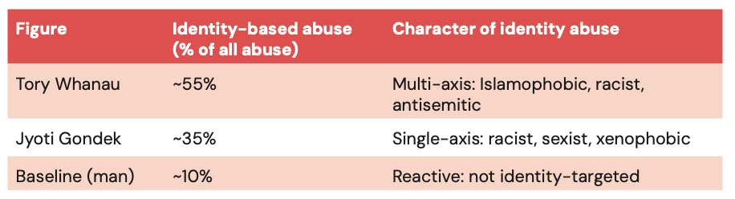

Impact
Problem: The public square has moved online but it no longer functions as a democratic space, especially for racialized women in public life, who face identity-based abuse that pushes them out of visibility and participation. When hostile voices dominate comment sections, the reasonable majority withdraws, and genuine civic dialogue collapses.
Impact: Candidates and their staff burn out and lose their sense of safety. Those who stay, struggle to see and respond to genuine constituent feedback that makes democratic accountability possible. The cost of participation is too high for many, resulting in fewer diverse voices in politics. The result is a public square that no longer reflects the communities it is meant to serve.

Slide 11
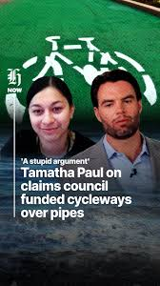
General Election: Tamatha
Anonymous blog states Tamatha prioritised increased cycle lane funding over pipes
Framed as her personal decision
Amplified by right wing groups, the Minister for Finance and media
Abuse escalates online and at public meeting
Anti-cycleway becomes core narrative
Same pattern of misinformation becoming key narrative.

Slide 12
The gap
Systems assume:
Rational actors
Good faith use of information
While these attacks have become more hostile, more extreme, and now reach far beyond the digital ecosystem, our current system remains inadequate in protecting individuals and their communities.
Telling leaders to be more resilient, to ignore the comments and being reactive is no longer acceptable.
1
Reality:
Coordinated bad actors
Incentives to amplify harm
2
3
Result:
Leaders exposed
Harm normalised
Democracy fails.
3

Slide 13
Possible solutions
SYSTEMS
PLATFORMS
LEADERSHIP
The UK and Australia have already started implement safety measures:
Online Safety Act 2023
Criminalising deep fakes
eCommissioner
Strategic priority (VAWG)
Code of Conduct
PRIVACY
Protection of information from weaponsation
MODERATION
Areto moderation
PATTERN RECOGNITION
Identify incoming abuse campaign
RAPID RESPONSE
Rapid takedown of doxxing, defamation, hate speech
COMMISSION
Independent body
TRAINING
Motion Integration
LEGISLATION & REGULATION
Update HDCA, Online Safety Act?
GOVERNMENT
Responsibility, Cabinet Manual, Te Tiriti obligations.
ACCOUNTABILITY & REPORTING
Media council, code of conduct
PROTECTION
Legal fund

Slide 14
Discussion
Any thoughts or questions?

Slide 15
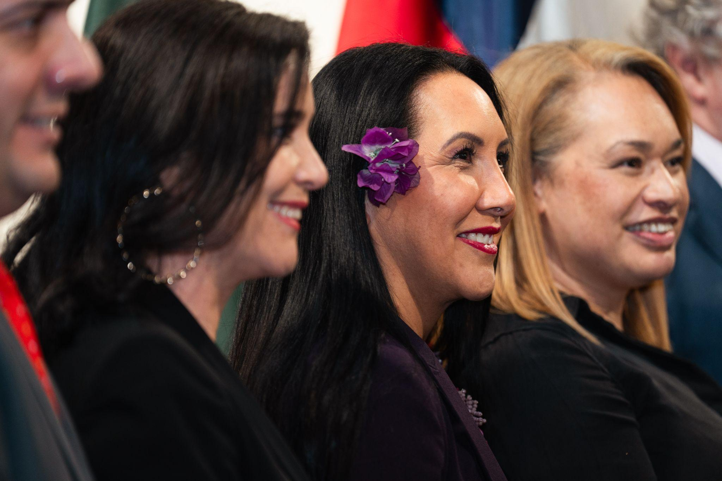
Thank You!

