Slide 1
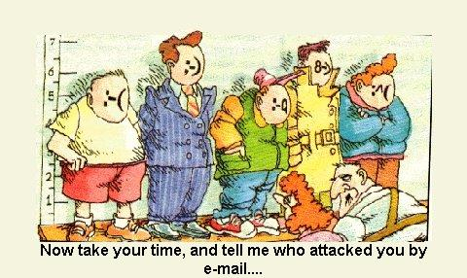
Malicious Yahoo! Xtra email attack: minimising customer impact

Slide 2
Short term
Dedicated internal comms team managing issue
Helping customers help themselves
balancing act
timely, relevant & targeted information
managing consistent internal & external comms across multiple channels
media & social media

Slide 3
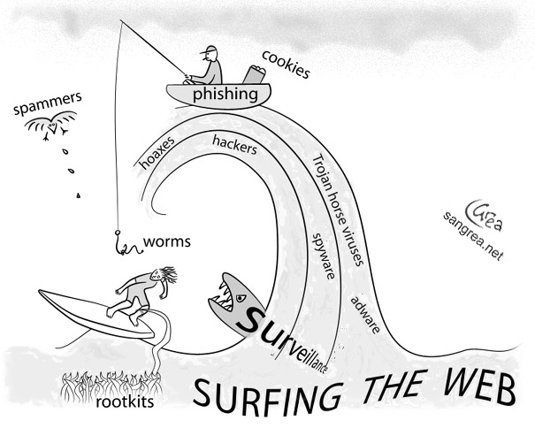
Long term – better prepared
Telecom - reviewed learnings to enhance internal processes and customer comms
Customers – good email security practices
educating customers
email attacks are a fact of life
how to protect yourself

