Slide 1
Designing for Privacy and Personal Autonomy
PrivacyLive
Office of the Privacy Commissioner of New Zealand
October 26, 2018

Slide 2
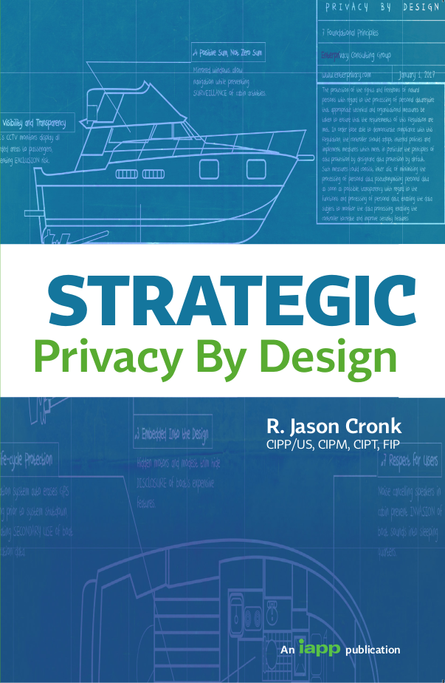
R. Jason Cronk
Principal Consultant
Enterprivacy Consulting Group (US Based)
Author of
Strategic Privacy by Design
20 year background in
Information Technology
Licensed lawyer in the U.S.
IAPP Fellow of Information Privacy
CIPP/US, CIPM, CIPT

Slide 3
Why design for privacy?

Slide 4




Why privacy by design?
Asymmetric Information

Slide 5


Why privacy by design?
Asymmetric Time Investment

Slide 6

Why privacy by design?
Asymmetric Time Investment

Slide 7
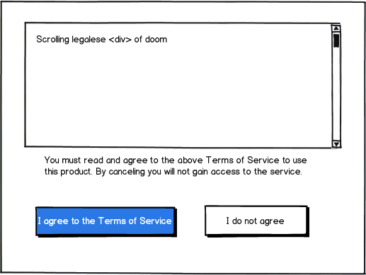
Why privacy by design?
Asymmetric Power
A contract that contains terms which consumers generally cannot negotiate, e.g. the fine print, whose terms are usually to the advantage of the seller and which may be onerous. They are typically preprinted, e.g. life insurance, and standardized contracts whereby a consumer is given an offer on a take it or leave it basis.

Slide 8
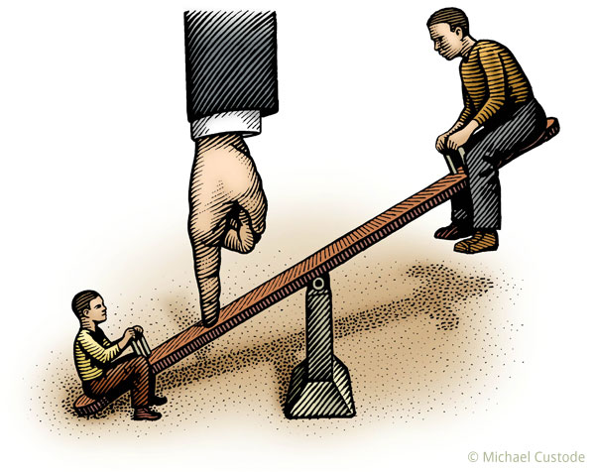
Legislating data as proxy for imbalance
Fair Information Practices
OECD Principles
GDPR Data Subject Rights
NZ Privacy Principles
Information Imbalance Notice/Transparency
Power Imbalance
Choice/Consent

Slide 9
What is privacy?

Slide 10
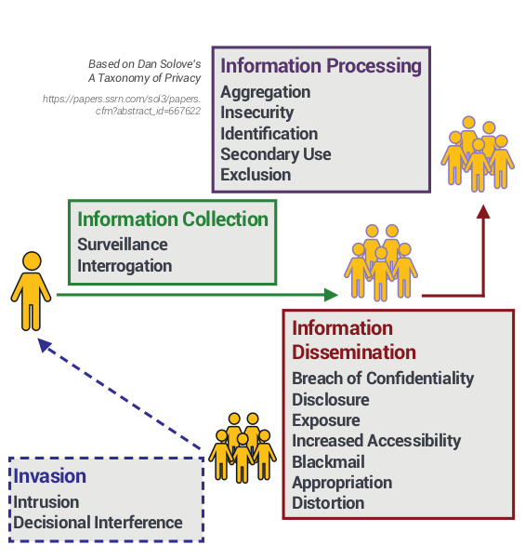
What is privacy?

Slide 11
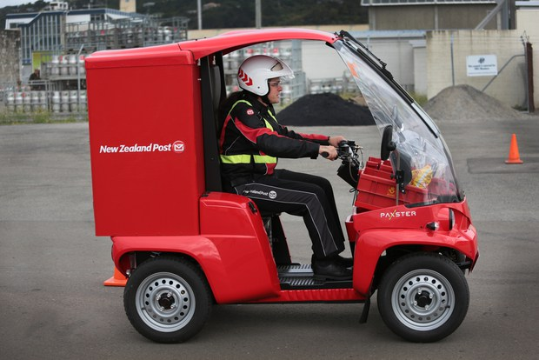
Surveillance
watching, listening to, or recording of an individual’s activities
Notes:
NZ Post will stop recording audio of people chatting to their postie at the letterbox.
The continuous audio recordings allowed for eavesdropping and had amounted to a "serious breach of the privacy", the Postal Workers Union says.
NZ Post's new delivery vehicle fleet - four wheel electric Paxsters - have high-resolution, forward-facing cameras with GPS.
https://www.stuff.co.nz/dominion-post/95736041/NZ-Post-to-silence-audio-recordings-on-delivery-vehicles-which-union-says-were-made-in-secret?cid=app-iPhone

Slide 12
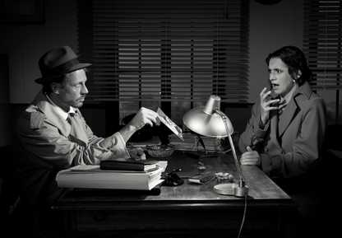
Information Collection
Interrogation
questioning or probing for personal information

Slide 13
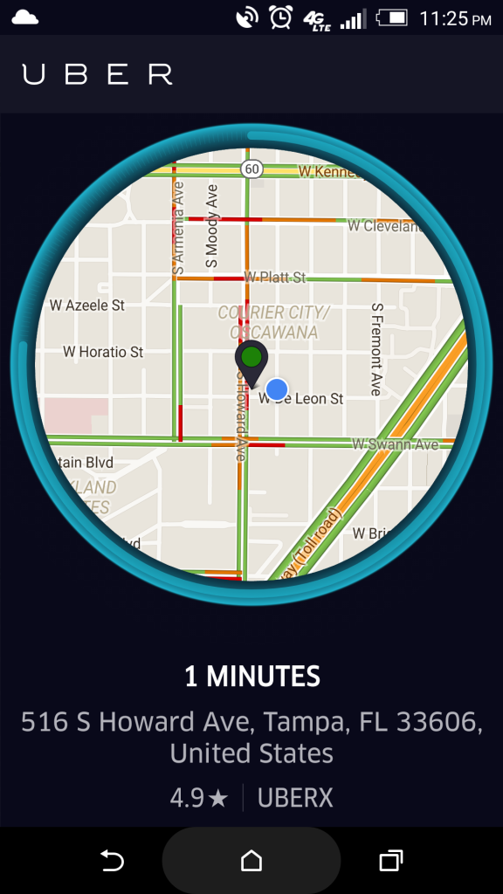
Exclusion
failing to let an individual know about the data that others have about them or participate in its use
Notes:
Public insurer ACC is using a secret computer model to predict how long clients will be on its books, then sorting and targeting those it considers a risk.
The software was built using the private information of thousands of ACC clients without their knowledge - and possibly without their consent.
It has had no public scrutiny or oversight from agencies such as the Privacy Commissioner, despite having potential mass privacy implications.
https://www.nzherald.co.nz/nz/news/article.cfm?c_id=1&objectid=11922430

Slide 14
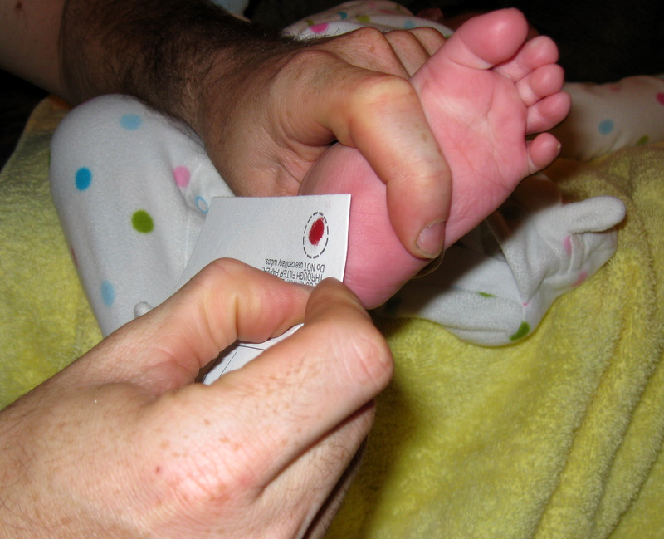
Secondary Use
using personal
information for a purpose other than for what is was collected
Notes:
The mother of murdered teenager Jane Furlong was stunned to learn blood samples taken from her daughter at birth were later used by the police to identify her body.
Police are able to seek access to the blood samples of more than two million New Zealanders under "exceptional circumstances".
Officers have used the database to prosecute two homicide cases, to test blood spots found in the Scott Watson murder investigation, and to identify the remains of missing persons, and victims of natural disasters.
https://www.stuff.co.nz/national/crime/97840280/parents-upset-at-police-access-to-baby-dna

Slide 15
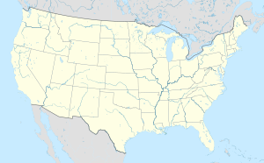

Information Dissemination
Distortion
disseminating false or misleading information
about an individual

Slide 16
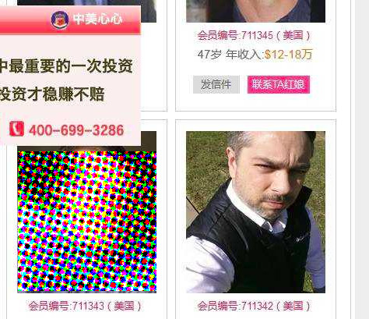
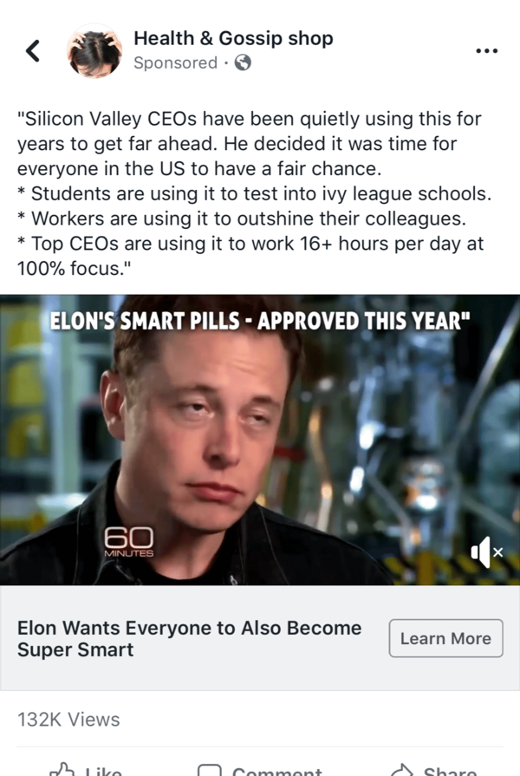
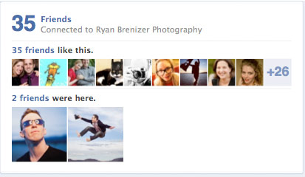
Appropriation
using an individual’s identity to serve the aims and interests of another

Slide 17


Intrusion
disturbing an individual’s tranquility or solitude

Slide 18
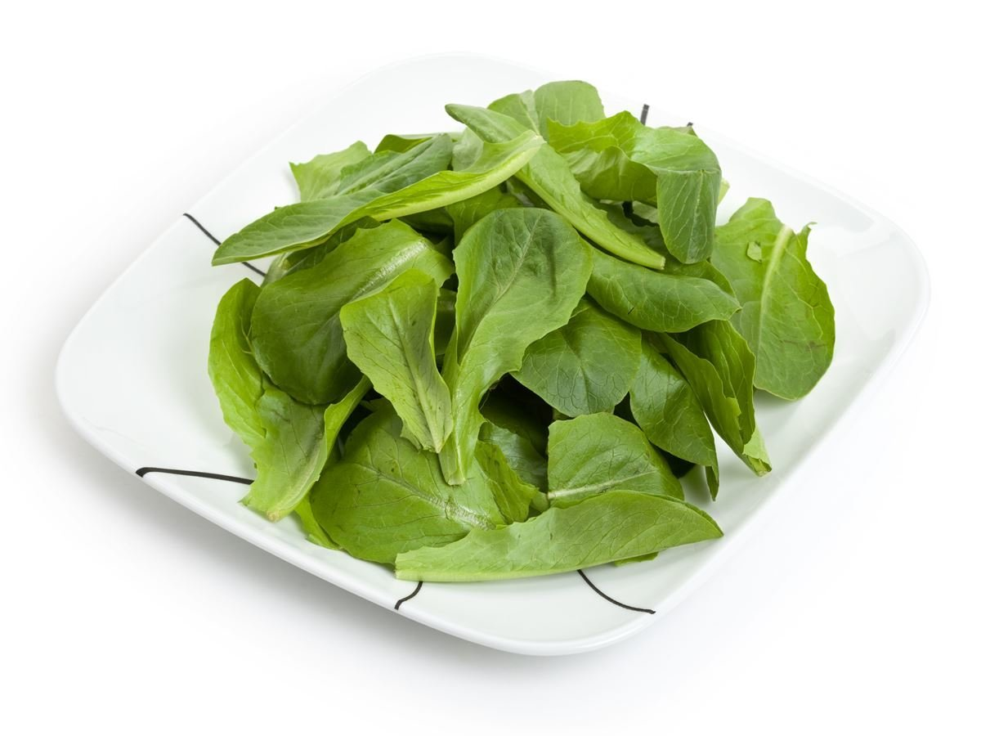
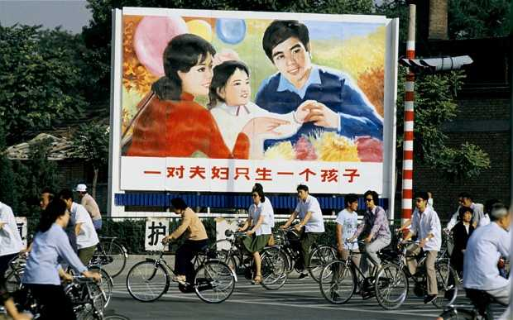
Invasion
Decisional Interference
intruding into an individual’s decision
making regarding
their private affairs
guilt, complaining, comparing, lying, denying (including excuses and rationalizations), feigning ignorance, or innocence (the “Who me?” defense), blame, bribery, undermining, mind games, assumptions, “foot-in-the-door,” reversals, emotional blackmail, evasiveness, forgetting, fake concern, sympathy, apologies, flattery, and gifts and favors.
<Coercion---------Manipulation-------Persuasion>

Slide 19
Manipulation online
Exploit human psychology
System I Thinking (automatic, unconscious, intuitive)
Need to belong to a social group
Nudging

Slide 20
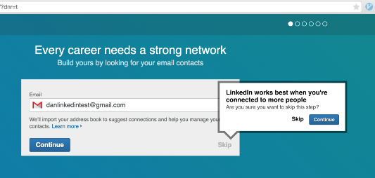
Manipulation online
Appeals to Need to Belong
Nudging
System I Thinking
AUTOMATIC, UNCONSCIOUS, INTUITIVE

Slide 21

Privacy violations
Researcher sharing of data with Cambridge Analytica
(Breach of Confidentiality)
Cambridge Analytica creating of psychographic profiles
(Aggregation/Secondary Use/Exclusion)
Manipulation of potential voters
(Decisional Interference)

Slide 22
How to design for privacy? `

Slide 23
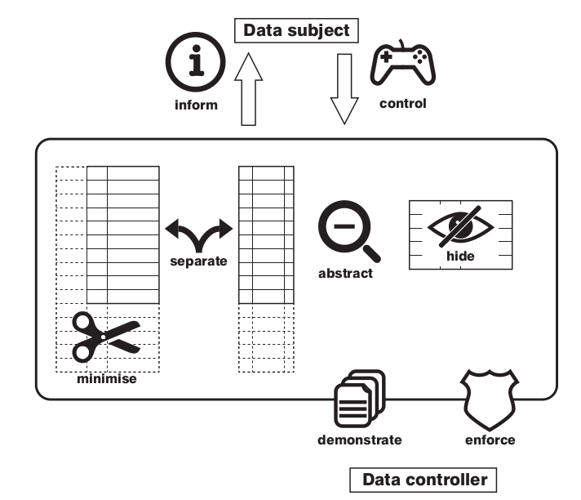
Hoepman Strategies
Adapted from M. Colesky, J.H. Hoepman, and C. Hillen. A Critical Analysis of Privacy Design Strategies. In 2016 International Workshop on Privacy Engineering IWPE'16

Slide 24
Strategies & Tactics
Data Oriented
MINIMIZE
SEPARATE
HIDE
ABSTRACT
Exclude
Select
Strip
Destroy
Distribute
Isolate
Restrict
Mix
Obfuscate
Dissociate
Summarize
Group
Perturb
INFORM
CONTROL
ENFORCE
DEMONSTRATE
Supply
Notify
Explain
Consent
Choose
Update
Retract
Create
Maintain
Uphold
Audit
Log
Report
Process Oriented

Slide 25
Obfuscate
When I was born 47 years ago, I spent two weeks in the hospital.
Two score and seven years heretofore, upon my nascency I remained in the sanitarium a fortnight.
اثنين من درجة وسبع سنوات حتى الآن، على بلدي نعمة ظلت في سانتريوم أسبوعين.
6a19700288c4a483a0a80e8812d4bc8086d45668cbbcef4959133b421efd99306aac3ba3f4a6f6cb08dfc287e27b239312ef94411e755d6c22a3d369985c51f789f61fa4af79f3248e0535b494f5dad550f7aa03221c789cf7c0f23e34c5f94411e75e

Slide 26
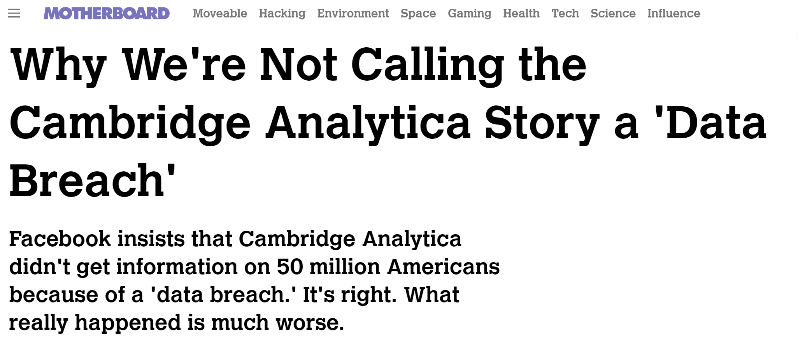
Privacy by Design Process
Minimize &
Separate
Hide &
Abstract
Enforce &
Demonstrate
Inform &
Control
ARCHITECT
SECURE
SUPERVISE
BALANCE
“But, for the most part, technologists and
firm lawyers thought about privacy in
narrow ways, either as synonymous with
encryption or limited to notice-and-choice.”
Prof. Ari Waldman

Slide 27
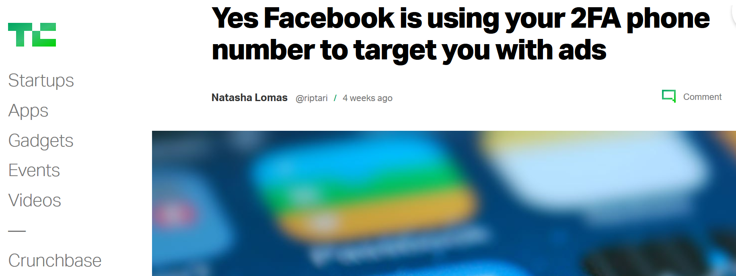
Privacy by Design Process
ARCHITECT
SECURE
SUPERVISE
BALANCE
Persons | Governments | Organizations
Revenge, money, spite, curiosity, & control. | Law enforcement, espionage, control & repression. | Money, competitive advantage

Slide 28

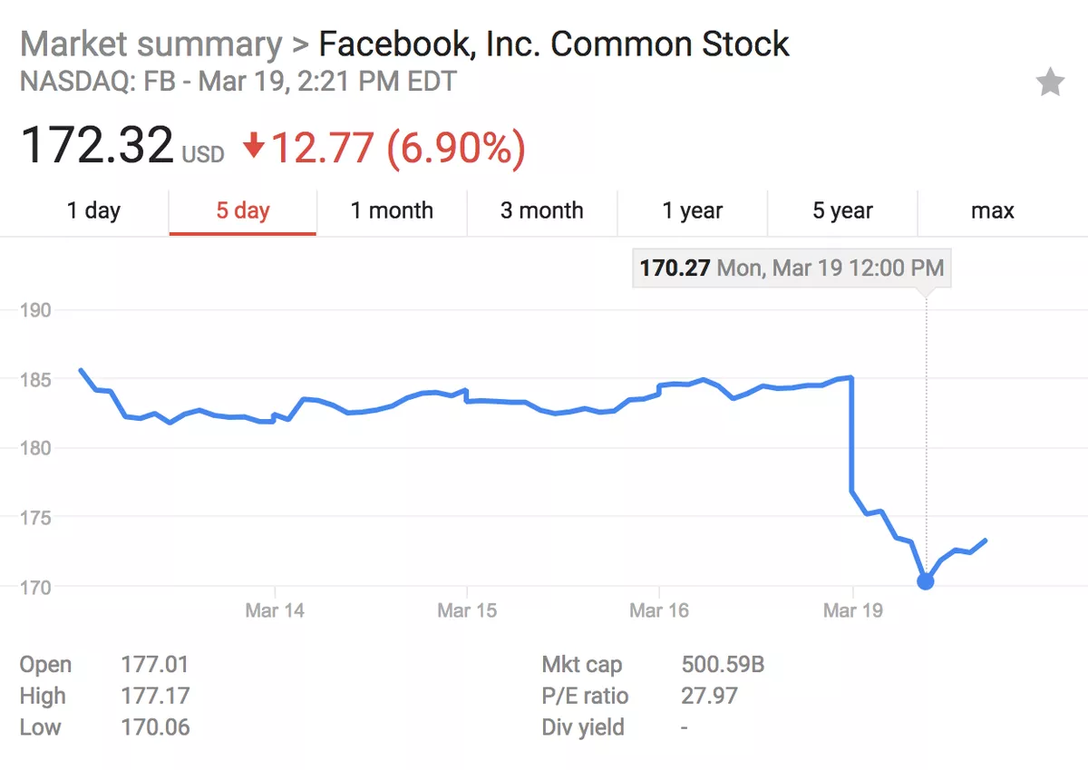
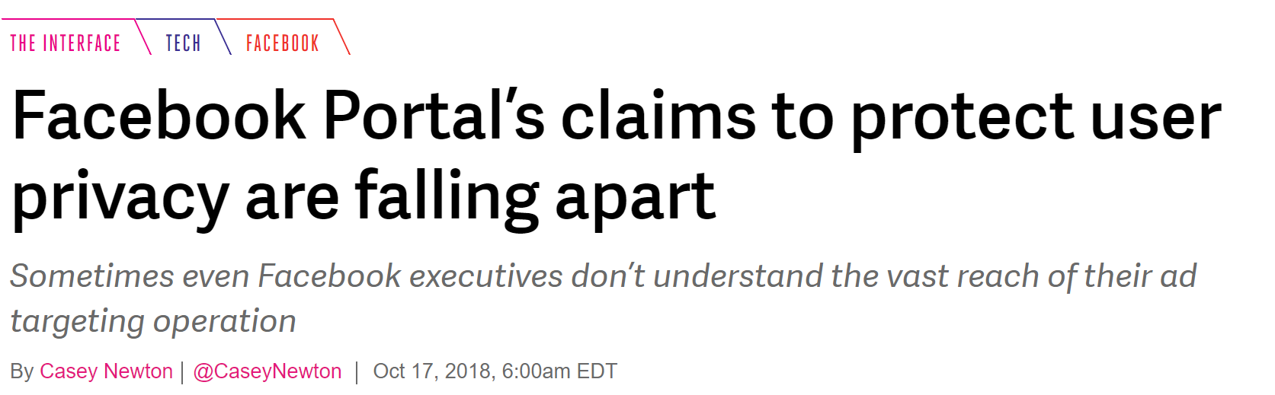
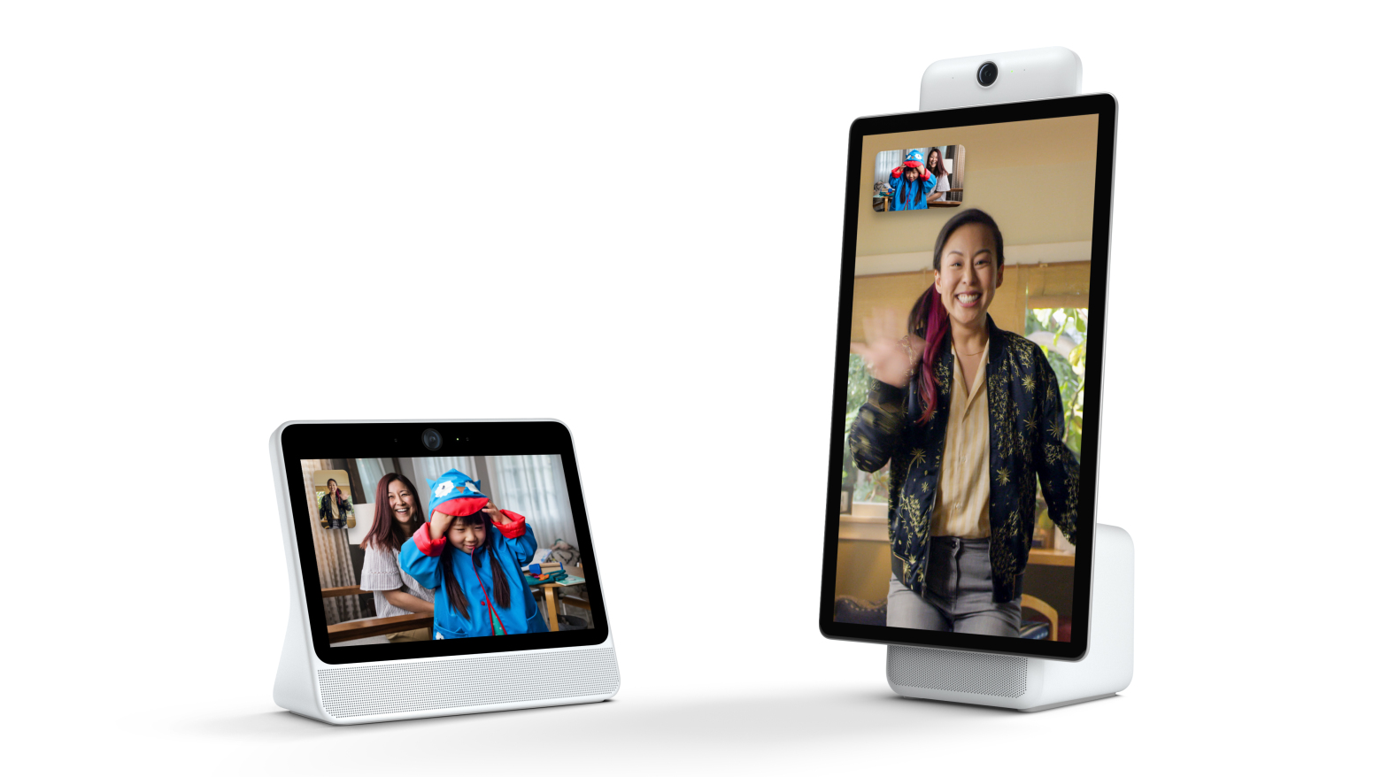
Trust
“Brought to you by the most trusted personal info broker
to ever testify before Congress”
“Just say no to Facebook’s spy device.”
“Please don’t video monitor me Facebook”

Slide 29
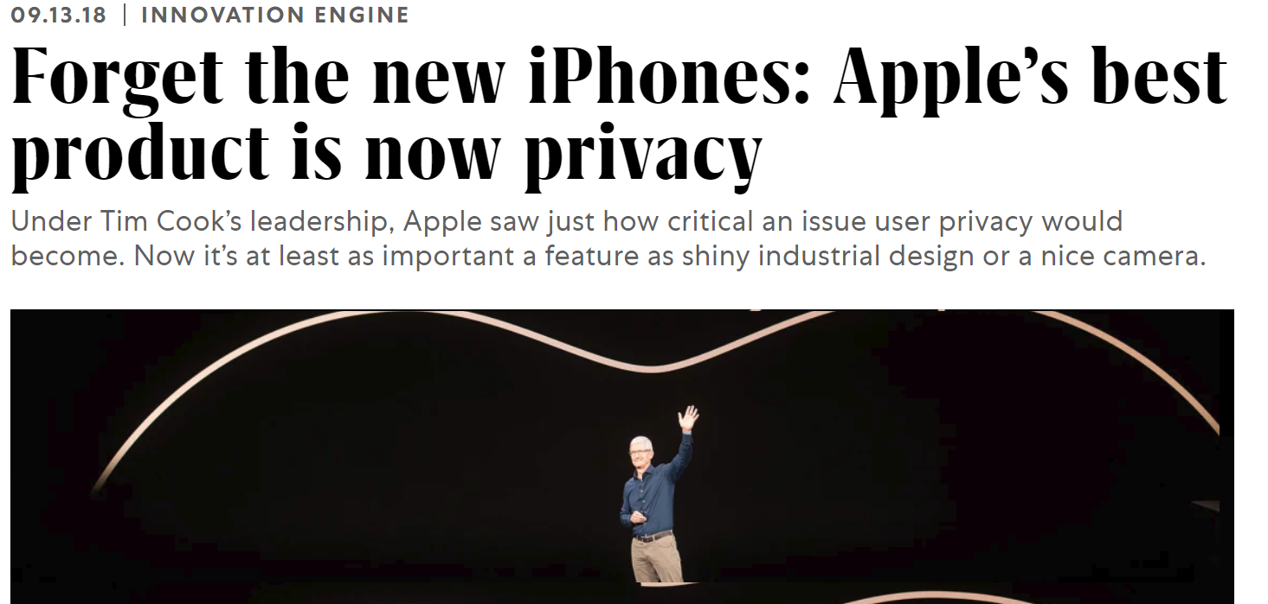
Trust

Slide 30

Going to the gym

Slide 31

Thank You
Thanks to

