Slide 1
Blockchain’s Promise for Privacy
Alex Sims – Talking About Privacy Tuesday 27 February 2018:

Slide 2
or

Slide 3
Most of what you have heard about blockchain is wrong

Slide 4
Distinct parallels with blockchain and the early days of the internet

Slide 5
Outline of talk
Defining (and therefore explaining) what blockchain is
Potential privacy issues with blockchain
Why absolute privacy does not exist
How the privacy issues are being resolved
Why privacy is broken at the moment and how blockchain can in fact help people regain their privacy
The law is the problem rather than the technology

Slide 6
Definition of a blockchain
A database so secure it can be made public where altering a copy of the database has no effect & transactions can only be appended, never deleted or updated
Underpinned by a Peer to Peer protocol that strictly enforces transaction validity prior to writing to the database

Slide 7
Some terminology…
Blockchain
= public and distributed – open source
Distributed Ledger Technology (DLT)
= permissioned or private – closed/proprietary but can be open source
(permissioned = industry/consortium only permitted to write and view, eg Hyperledger Frabric)
Private = one person/organisation has ability to write)
To not confuse everyone will use “blockchain” for both public, permissioned and private
Once move away from public blockchains you lose many of the benefits of Blockchain – ie becomes inherently less secure

Slide 8
More recent developments
If you think blockchain is hard to get your head around, blockchain is now “boring” there are other systems being developed, ie:
IOTA – tangle
Hashgraph
Rchain
Etc, etc

Slide 9
Uses of blockchain
Currently most people think blockchain = bitcoin = criminal activity
Or cryptocurrencies and speculation
But people (including governments) are working on uses of blockchain in almost every industry:
Supply chains including provenance
Health records
Distributed electricity grids
Education/credential certificates
Insurance
Registry systems, including land, cars, IP etc

Slide 10
Just to scare everybody – and this is not science fiction…
Blockchain enables programmable money:
Can put actual conditions on money, eg can only spend at certain preauthorized places, and/or can’t be used to buy certain things like alcohol (so more sophisticated than giving a card or voucher etc)
Those conditions could continue to apply as the money circulates, or could automatically be removed once the first transaction occurs or at a later date
If wanted could track and even control that money as it works its way through the economy
Eg, GovCoin has been trialed by the UK Government – with the unsurprising criticisms
https://theconversation.com/why-a-blockchain-startup-called-govcoin-wants-to-disrupt-the-uks-welfare-state-88176

Slide 11
Perfect Privacy isn’t realistic
While some people would like perfect privacy that isn’t possible in all settings, eg:
If walk down street can’t ask people not to look at you or if in the middle of Newmarket, not to take photos of you and your children…
If want to keep all financial transactions secret then have to use cash for everything, becoming harder to do so:
try living without a bank account, eg ask your employer to pay you in cash each fortnight!
Difficult to live without electricity and running water (you need to disclose who you are to get services…)

Slide 12
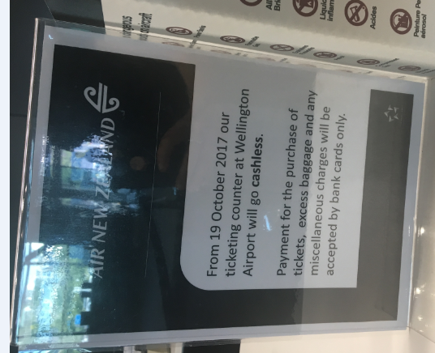

Slide 13
What’s the (potential) issue with privacy?
A public blockchain is a database that everyone can see into!
But not necessarily as simple as everything being seen
Next slide uses Bitcoin as an example

Slide 14
Bitcoin and privacy
You don’t “own” bitcoin
Instead bitcoin is recorded against a public key (a meaningless string of numbers that does not contain any identifying features of its owner), you can go online and see how much money belongs to a public key
Public keys are a bit like a bank account number (difference is that you can see all the bitcoin held by that public key and the transactions made to and from it)
Knowing the public key is not enough to spend it, you need to know the private key. Control over the private key is vital!
The hacks of bitcoin and other cryptocurrencies have been due to people getting hold of private keys, eg when a third party such as an exchange is hacked or a custodian of the private key uses it for their own puposes.

Slide 15
Bitcoin and privacy
Just by looking at the bitcoin blockchain you don’t know who owns what and who is transferring and receiving what
But it is possible in many cases to work out who is behind a public key – eg FBI officers who extorted Bitcoin from Silk Road participants were tracked down
But, now can use HD (hierarchical deterministic) wallets that generate a new public key each time that wallet is used so send and receive so that transactions can’t be tracked
=
Technology is fixing privacy and other issues
https://www.forbes.com/sites/laurashin/2016/11/01/federal-prosecutor-kathryn-haun-on-how-criminals-use-bitcoin-and-how-she-catches-them/

Slide 16
Other ways of protecting privacy
Zk-snarks, (zero-knowledge proof technology)
Used in Monaro and Zcash (pricacy coins)
Bulletproofs
Also/and – can use other forms of encryption so that some people can see some parts and others can’t see them – even easier if using permissioned blockchains (but not impossible if using a public blockchain)

Slide 17
Other concerns about privacy
Right to be forgotten
If information is on a blockhain it is immutable and is there for all time
Well yes that is the current design, but could have it so that the information is automatically deleted after a certain time:
But may not want that for say money…
With permissioned blockchains would be easier to have information deleted as does not “suffer” so much from a decentralised system
But if decentralised system run as a well functioning DAO then possible for information to be removed if there is a court order etc.

Slide 18
Blockchain’s possible effects?
While initially blockchain looks like a real threat to privacy, carefully handled blockchain could offer the same or even better privacy protection than the current systems

Slide 19
But wait, there’s more…

Slide 20
Why and how is current privacy protection so bad?

Slide 21
hint

Slide 22
the law is not the problem, it is the practical reality, ie real life that gets in the way!

Slide 23
Why and how is current privacy protection so bad?
To receive many services/goods etc (including healthcare, education, a roof over your head etc) you are required to provide personal information to each provider, including:
Name, address (and often proof of address), sometimes birth date, copies of government identification, eg passport/drivers license/birth certificate, bank/credit card information
Your personal information is held by tens if not hundreds of different agencies – just takes one to be compromised and your personal information is out there for others to mis(use)

Slide 24
Current system is woeful
You don’t control your data, the people who hold it do
Blockchain can change that
Just some of the biggest data breaches of the 21 century, numbers of accounts (and thus people):
Equifax (143 million
Adult Friend Finder (412 million)
Anthem (78 million)
eBay (145 million)
JP Morgan Chase (76 million)
Yahoo (3 billion)
Target Stores (110 million)
US Office of Personnel Management (77 million)
https://www.csoonline.com/article/2130877/data-breach/the-biggest-data-breaches-of-the-21st-century.html

Slide 25
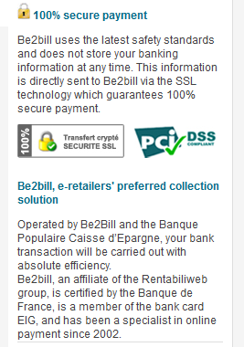
Privacy can be enhanced by not holding personal information
Benefits of not keeping some customer data has been recognised, ie merchants wanting to receive credit card payments have to be PCI complaint - the credit card companies have forced PCI compliance on the banks which in turn require it from their customers
Easiest way to be PCI complaint is not to store credit card numbers, have all payments done by third party, ie PayPal – but even then not secure
http://bgr.com/2016/01/04/paypal-account-security-hackers/

Slide 26
Federated v Self Sovereign Identity
Federated – can access services etc through existing account, ie when sign in using Facebook or Google etc (= it is handy, but it gives Facebook and Google etc even more control over our lives…)
Self Sovereign – you control your information and grant others the right to check that information is correct
Eg, if asked for ID to prove over 18, request is made, is person over 18 – answer will be yes or no
So no need to hand over driver’s license or passport that contains lots of personal information you may not want others to see
https://medium.com/@gomedici/21-companies-leveraging-blockchain-for-identity-management-and-authentication-d09d88e3a4bf

Slide 27
But, surely having one place where all information is makes that place a more attractive target to hack?
Need to move out of old fashioned/traditional thinking of centralised organisations…
Can have each person and only that person holding the information, for example, Civic
With Civic the information is hashed (and thus encrypted) to your phone so even if your phone is compromised only your information is compromised, not millions of people’s information
https://www.civic.com

Slide 28
Law may be the obstacle
GDPR (General Data Protection Regulation) comes into effect on 25 May 2018
Blockchains, especially decentralised ones, do not work well with GDPR
Any NZ business that handles the personal data of EU residents has to have a compliance plan in place
There are potential workarounds so can use blockchain and be complaint with GDPR, but many of the benefits of blockchain will be lost and they lessen the privacy afforded to people…
https://medium.com/wearetheledger/the-blockchain-gdpr-paradox-fc51e663d047
https://www.hlengage.com/_uploads/downloads/5425GuidetoblockchainV9FORWEB.pdf

Slide 29
Conclusion
Blockchain as with any technology can be used for good and bad
Blockchain has the potential to dramatically aid privacy rather undermine it:
We can do things that we couldn’t do before

Slide 30
Questions

